Slide 1


From a social to an ecological model of recovery
Professor David Best
Leeds Trinity, Australian National University, Monash University, Recovery Outcomes Institute

Slide 2
What does a strengths-based process mean?
From expert-patient to partnership
From deficits to strengths
From clinic to community
From the individual to the social
From professional to peer-based
From replication to continuous innovation

Slide 3
A core summary of recovery research evidence
Jobs
Friends
Houses
Somewhere to live
Someone to love
Something to do

Slide 4
Recovery studies in Birmingham and Glasgow – GOYA (Best et al, 2011a; Best et al, 2011b)
  UK Study of recovery wellbeing –better recovery wellbeing predicted by:
  1. More time spent with other people in recovery
  2. More time in the last week spent:
    Childcare
    Engaging in community groups
    Volunteering
    Education or training
    Employment

Slide 5
Best et al (2013): The role of abstinence and activity in promoting wellbeing among drug users engaged in treatment. Journal of Substance Abuse Treatment, 30 (4), 397-406
The study assessed changes in meaningful activities in three English Drug Action Team areas over the course of one year
Drug treatment participants split into four categories;
  Initiated meaningful activities
  Maintained meaningful activities
  Stopped meaningful activities
  No meaningful activities
Quality of life and wellbeing higher (and more abstinence) in those who started or maintained meaningful activities.
Stopping associated with decreases in all three wellbeing

Slide 6

What enables recovery change?
Strength-based approaches
Leamy et al (2011), British Journal of Psychiatry
CHIME
  Connectedness
  Hope
  Identity
  Meaning
  Empowerment

Slide 7
Recovery Capital: The concept of capital
“Social capital, human capital, recovery capital and restorative capital are unlike financial capital in that they are not depleted through use. When you spend your money from the bank, you deplete your capital. When you trust someone, you do not deplete trust: trust tends to be reciprocated and this engenders virtuous circles of trust-building. A politics of hope is likewise redemptive as we face adversity; it is infectious”
(Braithwaite, 2022, p. 363).

Slide 8
What is Recovery Capital?
Granfield and Cloud (2008) define recovery capital as
  “The breadth and depth of internal and external resources that can be drawn upon to initiate and sustain recovery from AOD [alcohol and other drug] problems.”
White and Cloud (2008):
  “Stable recovery best predicted on the basis of recovery assets not pathologies.”

Slide 9
Best and Laudet (2010)
Social Recovery Capital
Collective Recovery Capital
Personal Recovery Capital

Slide 10
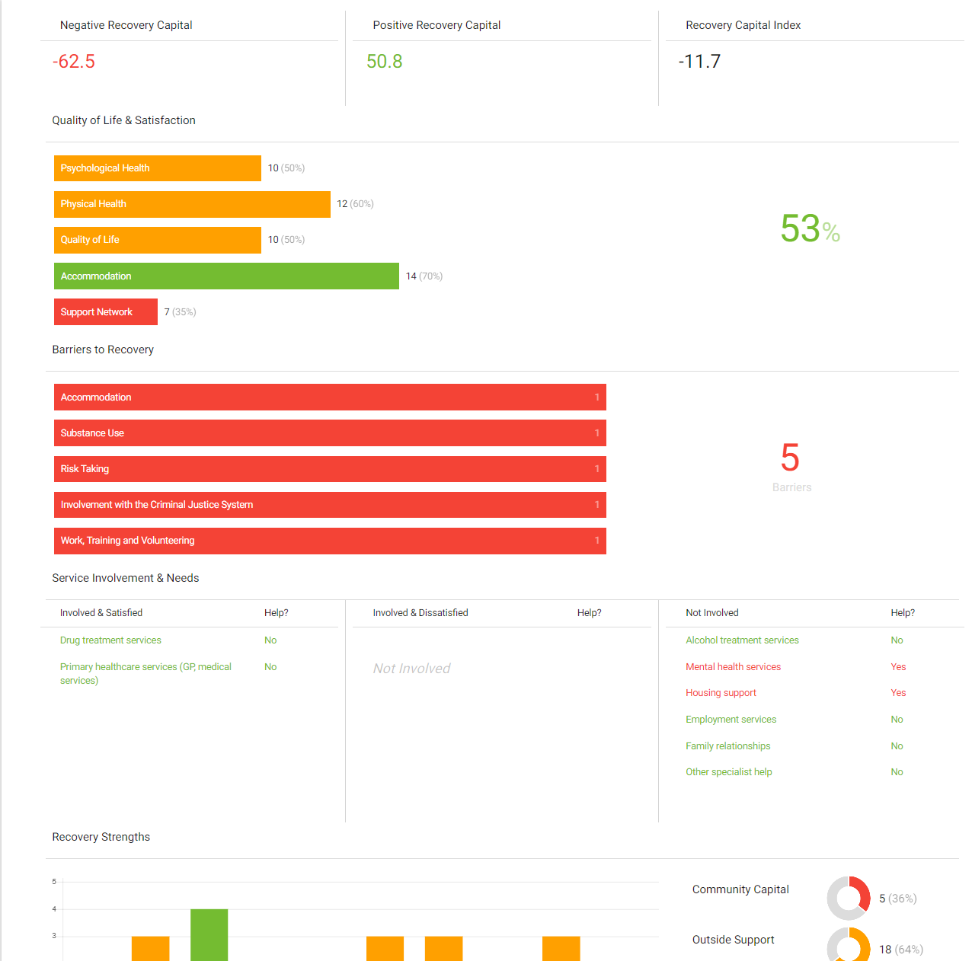
REC-CAP SCALES

Slide 11
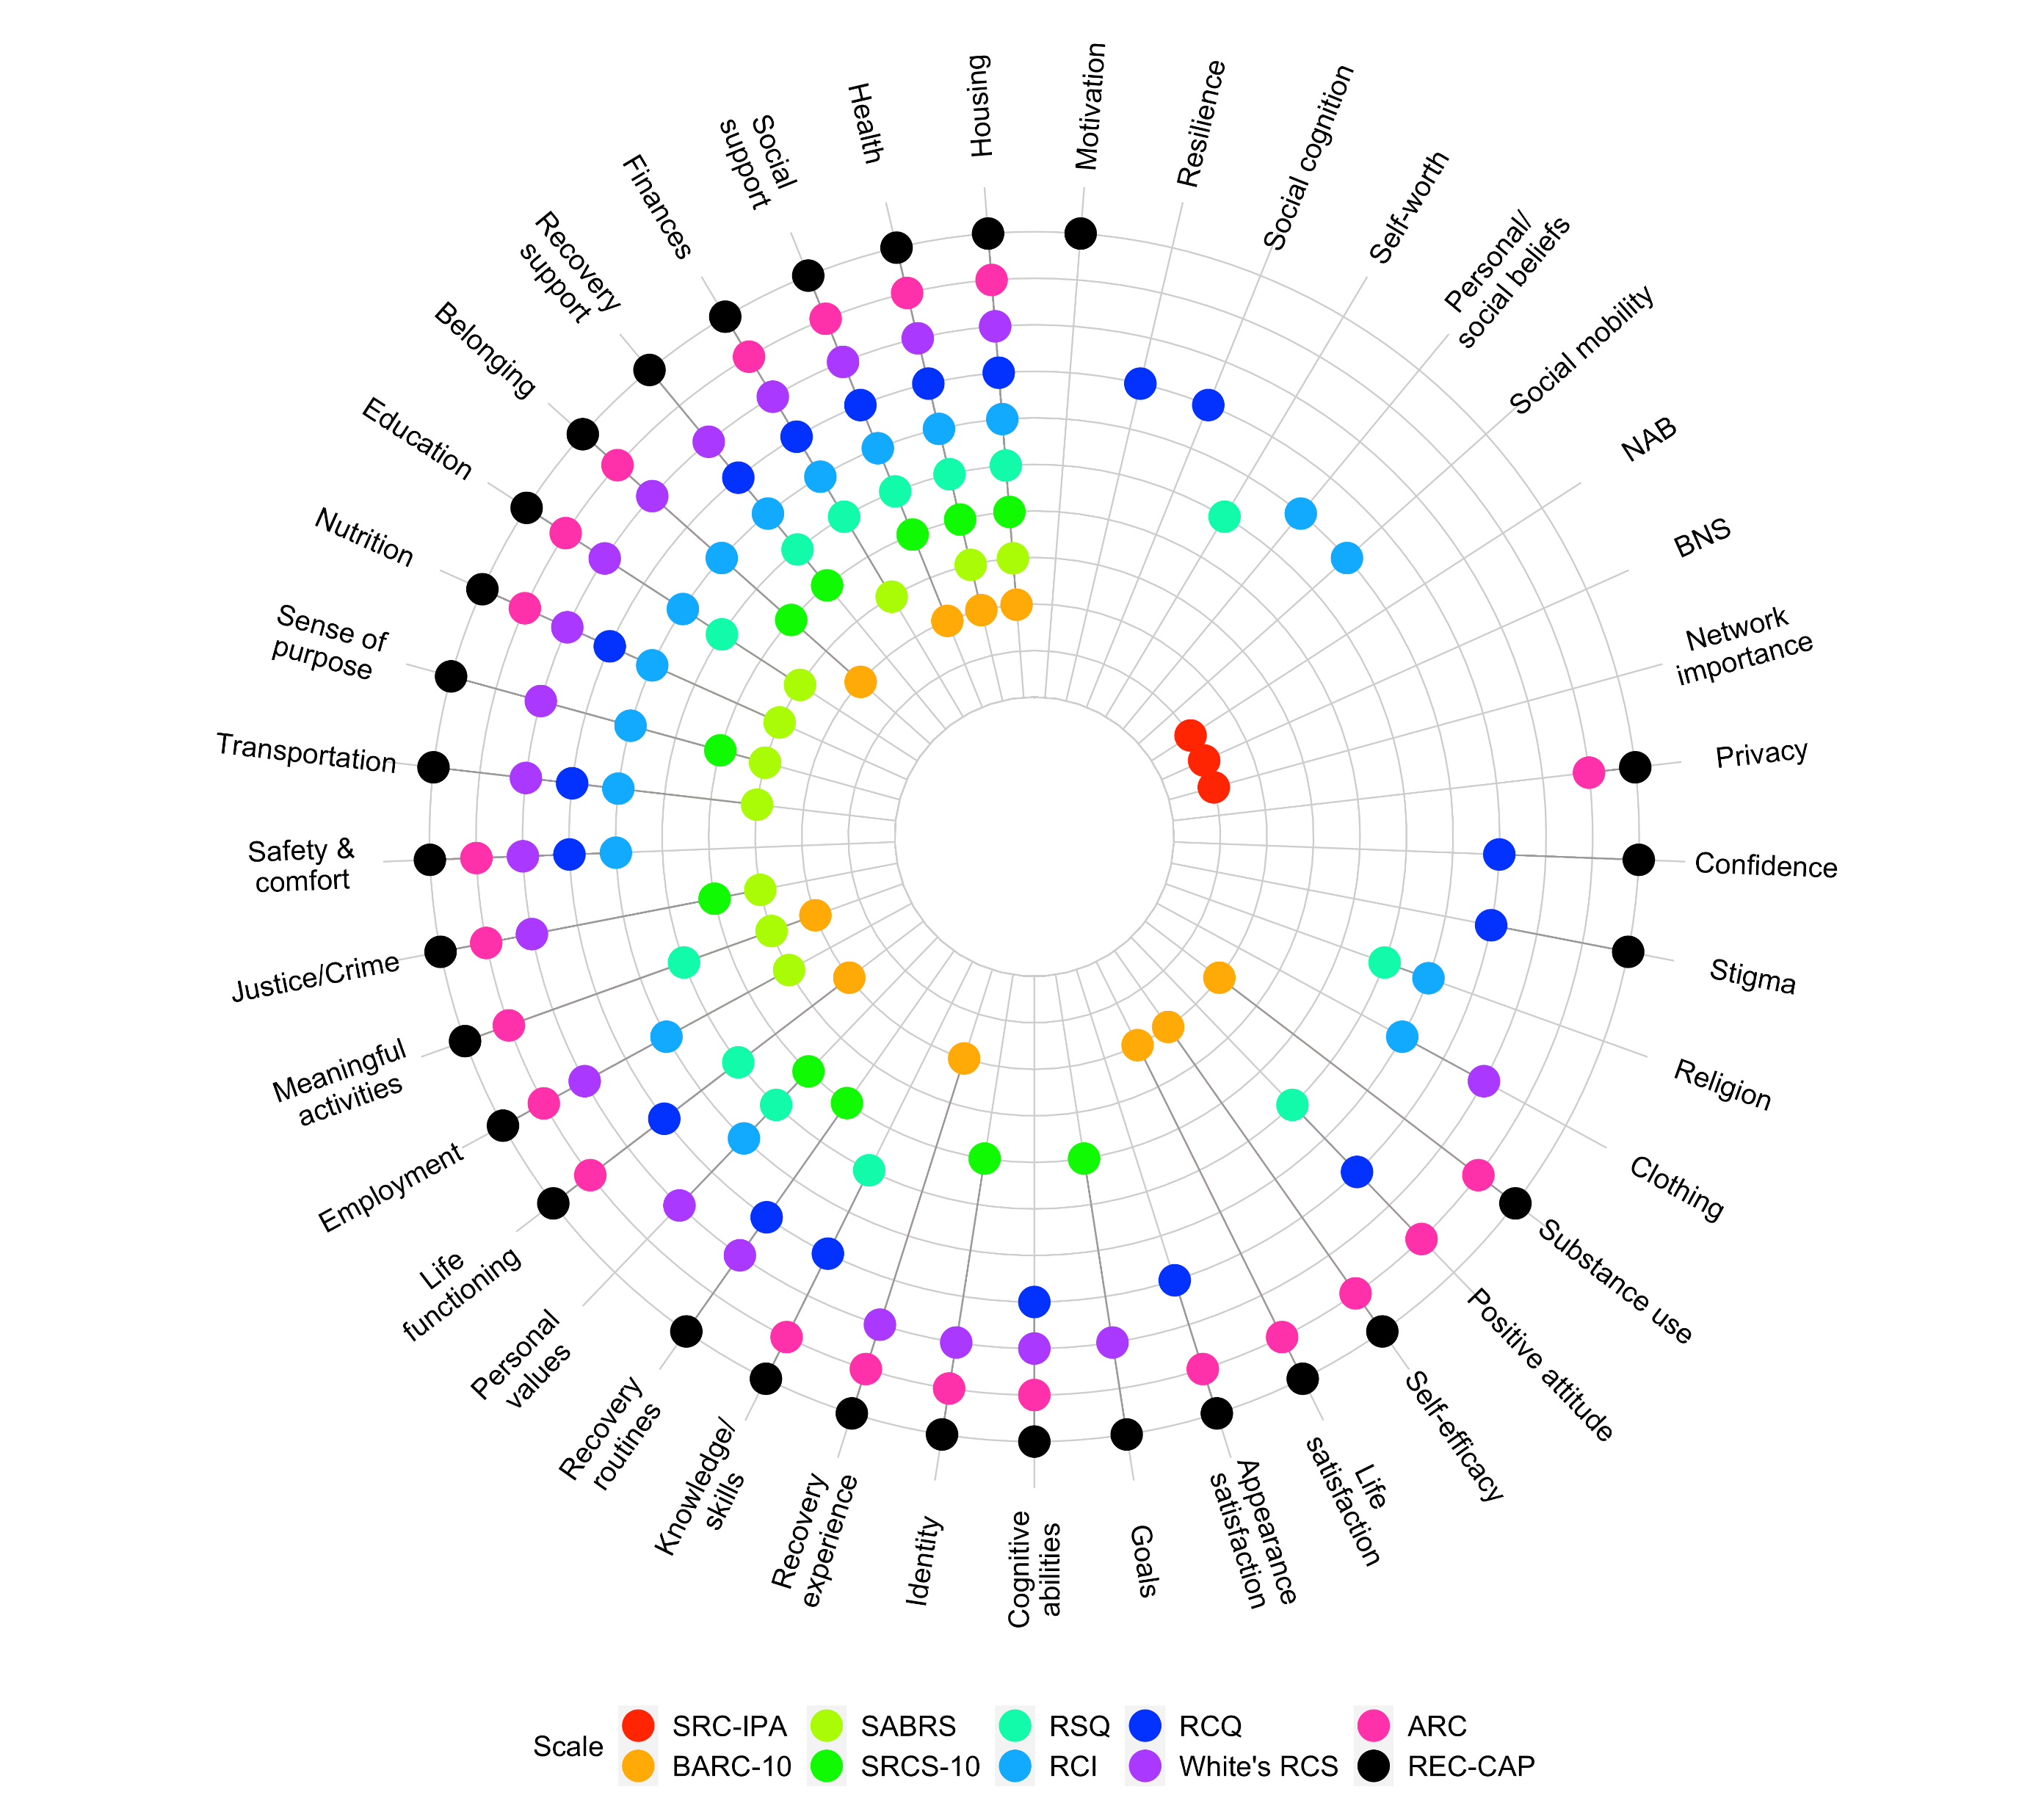

Slide 12
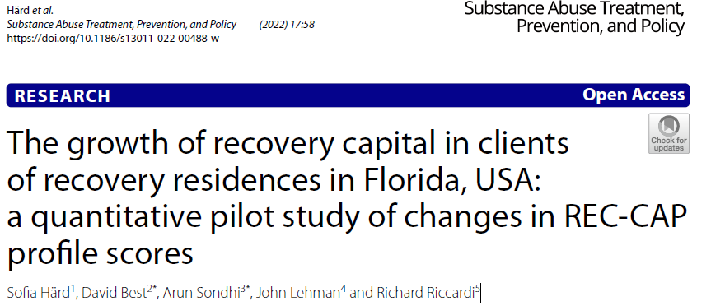
Mapping retention and changes in recovery capital

Slide 13
Virginia Association of Recovery Residences (Best et al, 2023)
Key political implications around younger, non-white clients and women less likely to be retained
For those retained, positive change associated with:
Employment
Greater recovery community involvement
Less housing instability
Better social support

Slide 14

Best et al (in press) – “Bridging the gap: Building and sustaining recovery capital in the transition from prison to recovery residences
Based on the HARP Therapeutic Community Model at Chesterfield County Jail
Clear evidence of recovery capital building in jail
But this continued to recovery residences and clear evidence of continuing and linear evidence of growth
Journal of Offender Rehabilitation

Slide 15
Overall Recovery Capital Score (ORCS)
The ORCS = recovery strengths minus recovery barriers.
The ORCS increased over time.
Males tend to report higher mean ORCS over time, compared to females.

Slide 16
Pilot vulnerability score
A pilot vulnerability score was created based on Cloud & Granfield’s (2008) conceptualisation of four factors that may impose challenges to recovery:
- Having mental health difficulties
- Experience of incarceration
- Female gender
- Being older
The pilot score could range from 0 to 4 vulnerabilities.
Individuals with more vulnerabilities reported less recovery capital.

Slide 17




Pilot testing the care planning manual
Manual outlining how to use the REC-CAP scores to create a care plan based on node-link mapping
Three maps for care plans
+ Building on your success
Hitting a brick wall
To be piloted in four sites – two in the UK and two in the US

Slide 18
Who needs community engagement?
Community Connectors
What steps are necessary?
Asset Based Community Mapping
Training and developing community connectors
Preparing clients to engage with groups
(and assessing their readiness)
Feedback loops and mutual benefit
Creating in-reach and out-reach models
1
Those who are socially isolated and excluded
Those whose networks are harmful to their recovery
2
3
4
5

Slide 19
Manning et al (2012)
Problem
Trial Conditions
Outcomes
  Acute Assessment Unit at Maudsley Hospital:
  Low client meeting attendance rates while on ward
  RCT with three conditions:
  Information only
  Doctor referral
  Peer support
  Those in the assertive linkage condition:
  More meeting attendance on ward (AA, NA, CA)
  Reduced substance use in the three months after departure

Slide 20


Recovery Capital Exploration
R1LEARNING.COM
Copyright 2023, R1 Publishing LLC

Slide 21
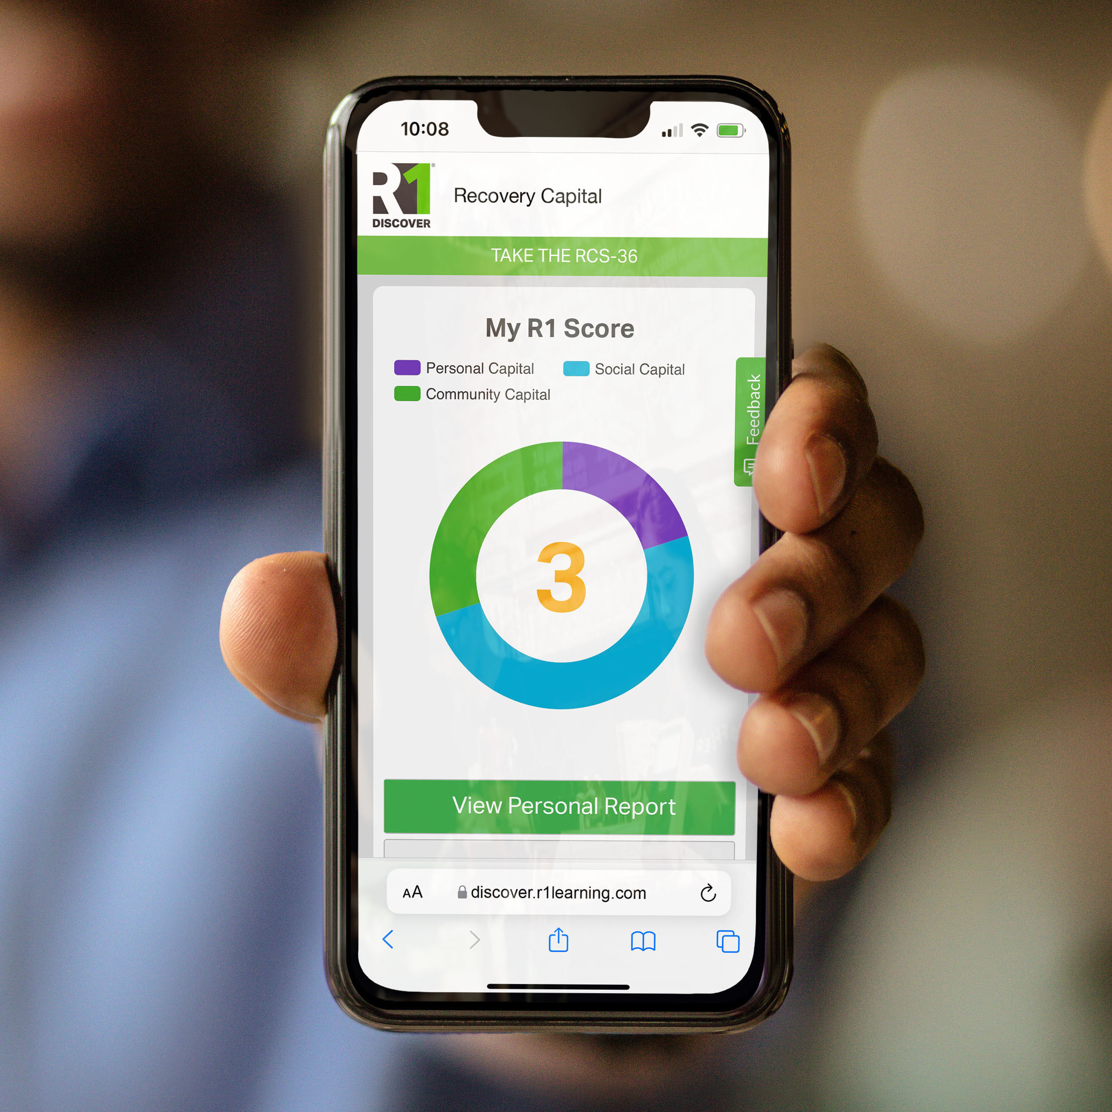
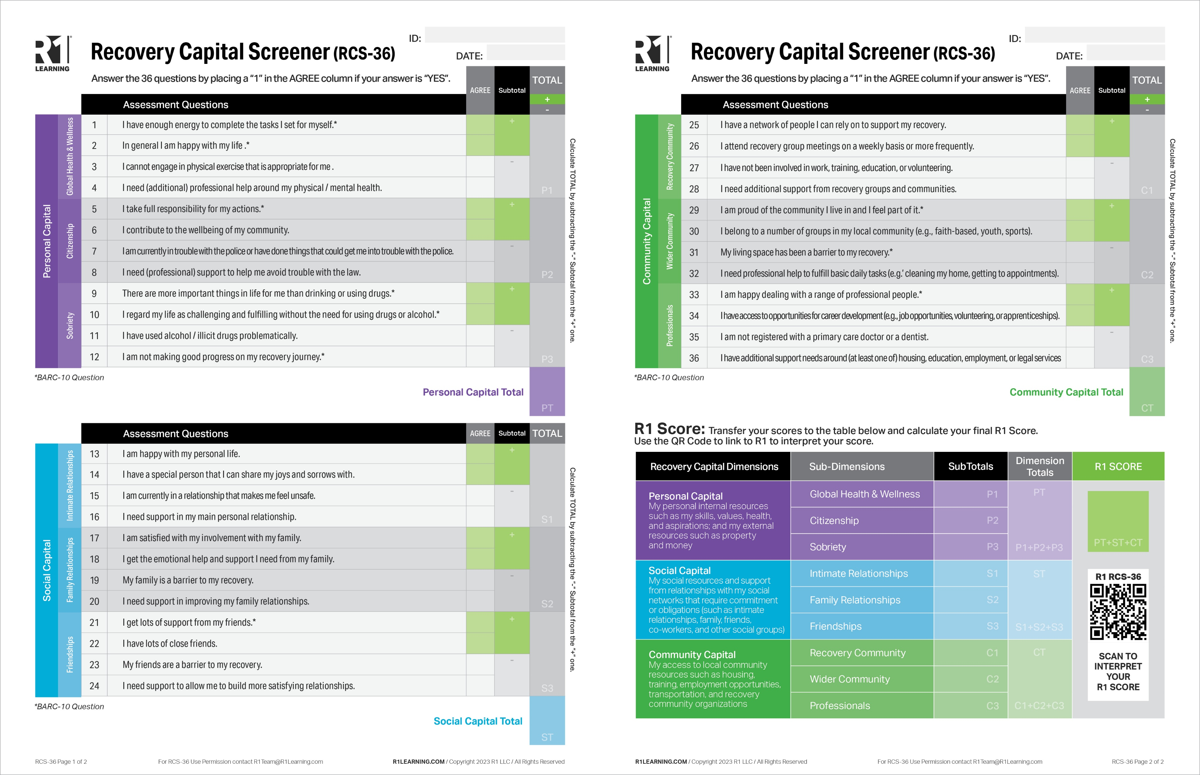
Recovery Capital Screener (RCS-36)
R1LEARNING.COM
Copyright 2023, R1 Publishing LLC

Slide 22

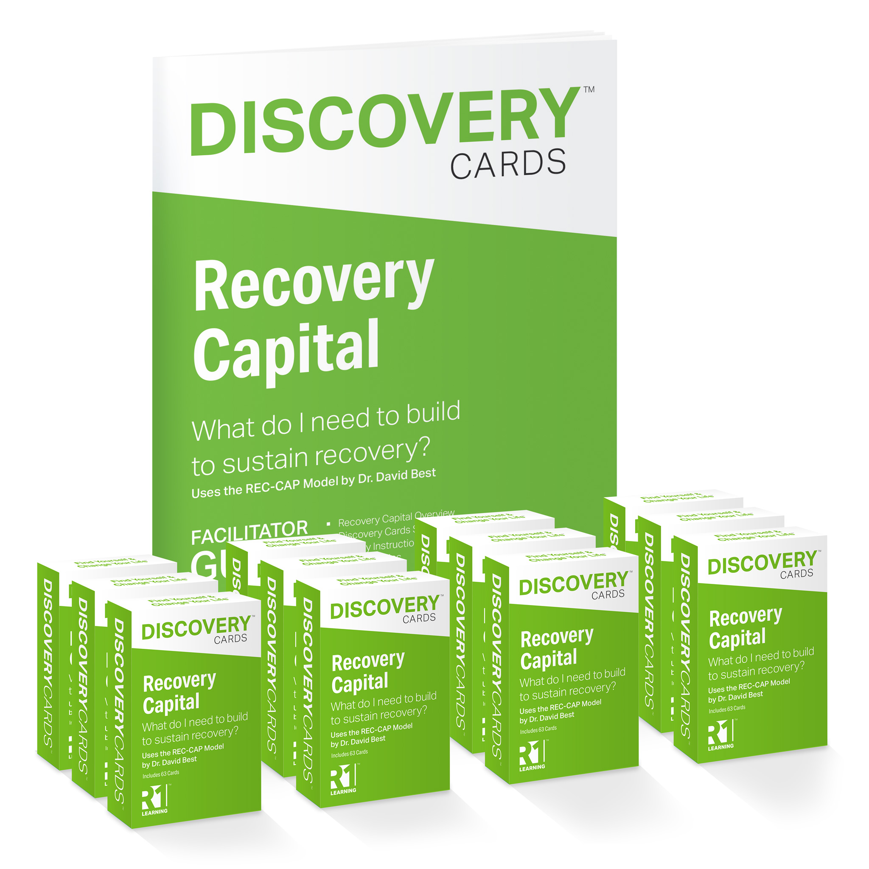

Recovery Capital Exploration
R1LEARNING.COM
Copyright 2023, R1 Publishing LLC

Slide 23


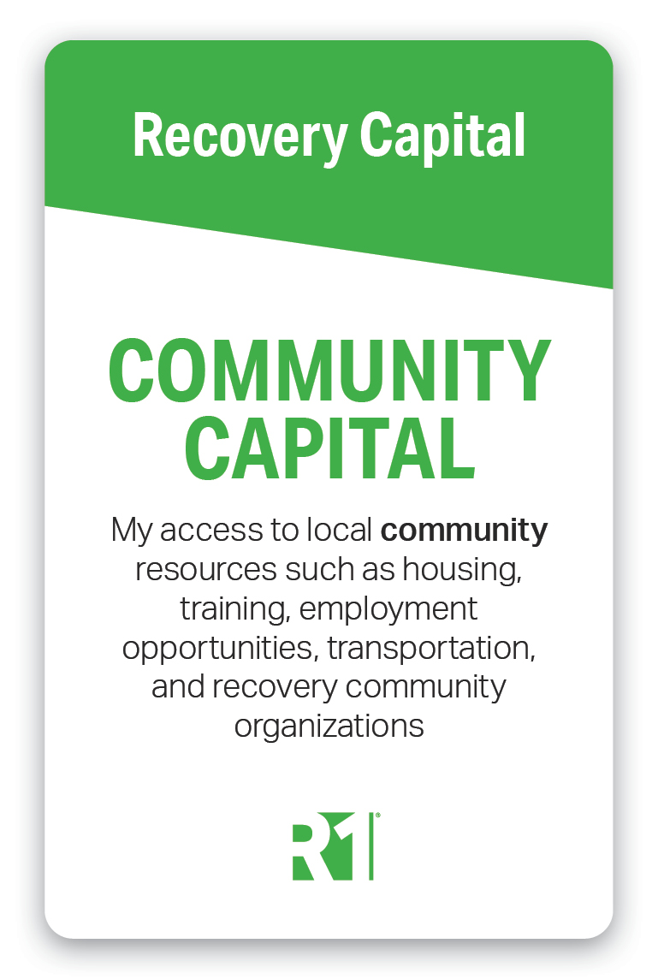
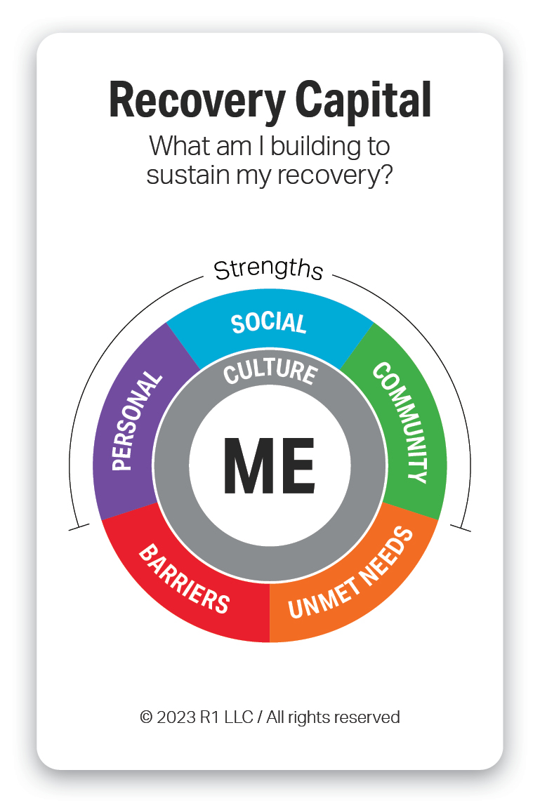
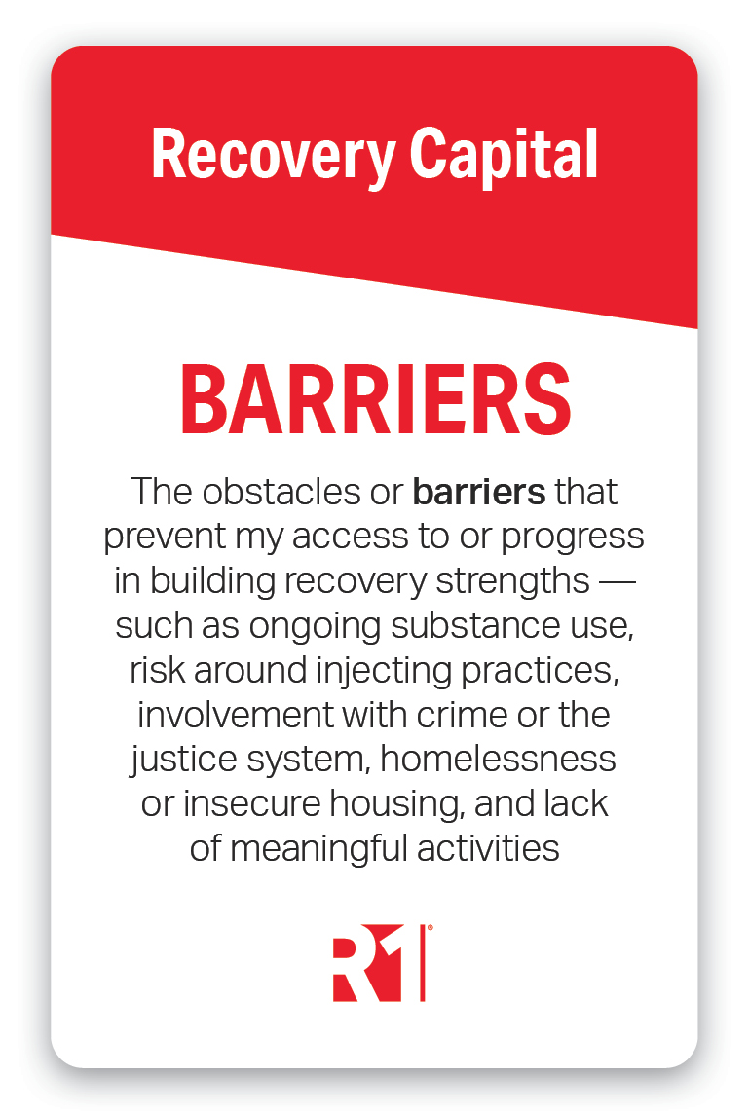
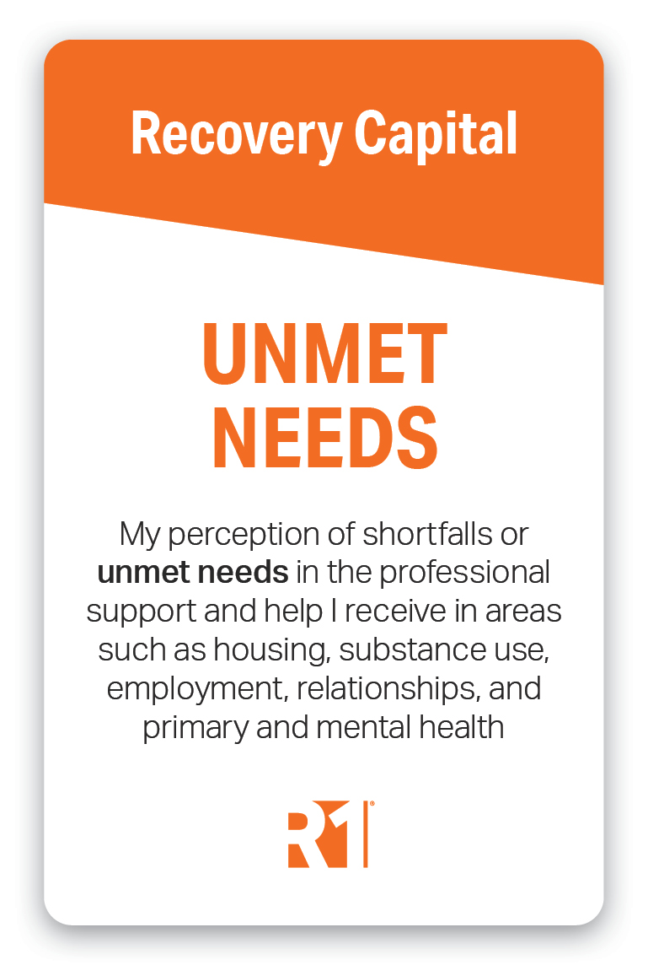
Recovery Capital Dimensions
R1LEARNING.COM
Copyright 2023, R1 Publishing LLC

Slide 24
Organisation
Workers / Peer mentors
Individuals

Slide 25
So what is a recovery-oriented system of care?
White (2008): “the complete network of indigenous and professional services and relationships that can support the long-term recovery of individuals and families and the creation of values and policies in the larger cultural and policy environment that are supportive of these recovery processes” (page 28)

Slide 26

So what is different about Inclusive Recovery Cities?
They are ROSCs ++
The key additional elements are about:
  Coordination and integration
  Innovation
  Social enterprise
  Giving back
  An Inclusive Recovery City is a city where the implementation of recovery models and principles makes the city a better place to live for everyone, and which implements an ROSC at a city level

Slide 27
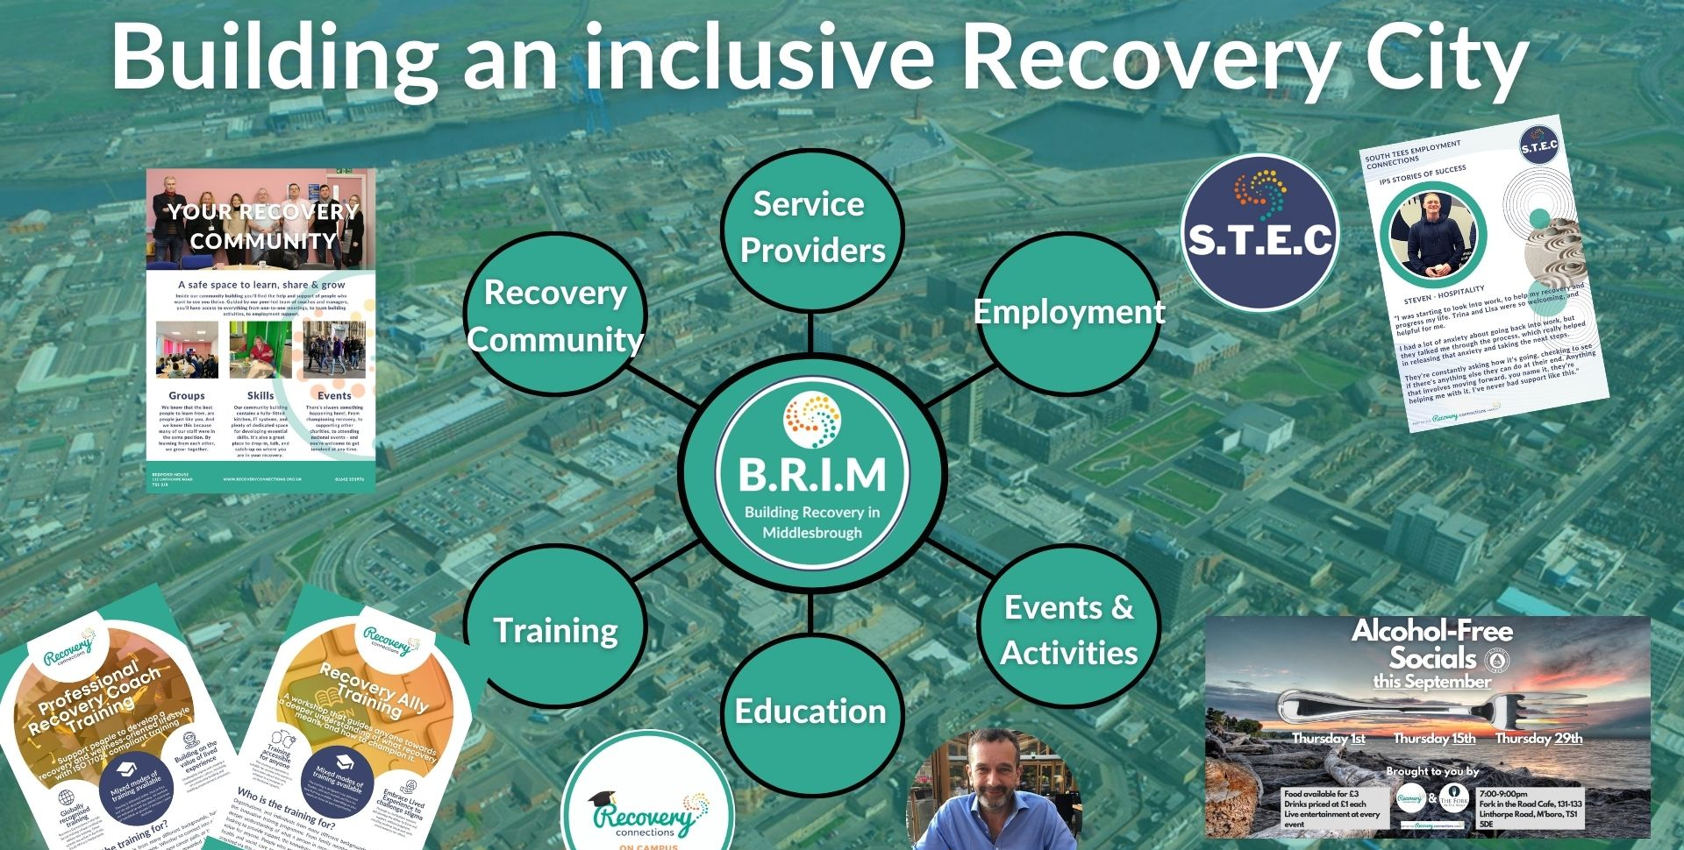

Slide 28
Key concepts and conclusions
CHIME
Recovery Capital
Contagion and community
Cascades for professionals to mirror contagion for individuals
ROSC and Inclusive Recovery Cities
From the social to the ecological

Slide 29
THANK YOU!
D.Best@leedstrinity.ac.uk
www.cultivatingrecoverycapital.com

