Slide 1




Islands in the stream.
Qualitative study on the accessibility of mental health
care for persons with substance use problems
EWODOR Conference
23-24 October 2023, Dublin (Ireland)
Clara De Ruysscher, Jürgen Magerman, Ilse Goethals, Mégane Chantry,
Jessica De Maeyer, Pablo Nicaise & Wouter Vanderplasschen

Slide 2


Background.
High prevalence of substance use among persons with mental health problems and vice versa (20-50%)
Challenges related to complex and long-term recovery trajectories
Belgian context: mental health networks
Poor integration and collaboration between ‘generic’ mental health services and specialized addiction treatment services despite network structure
Substance Use and Mental Health Care Integration (SUMHIT) project aims to study the integration between both sectors, through three lenses: (1) service users, (2) care professionals and services, and (3) service networks
New Drug Policy Framework (2001)
‘Article 107’ Mental Health Reform (2009)

Slide 3

How do persons with substance use problems experience the accessibility of mental health care in Belgium?

Slide 4
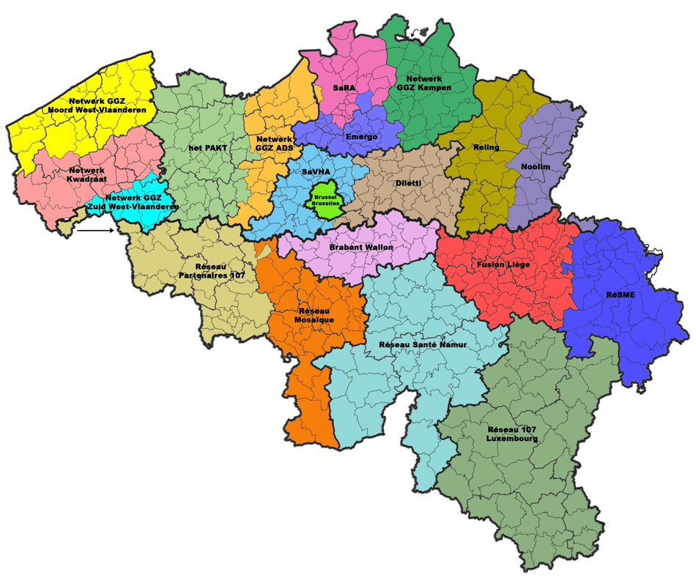
Methods.
In-depth interviews with 53 participants across 5 local mental health networks
  High heterogeneity regarding care function, substance use severity level, recovery stage, impacted life domains
  Special effort to include persons who are not in contact with treatment through snowball sampling
Focus on (un)met needs, use of services and lived experiences of (in)accessibility
Inductive thematic analysis

Slide 5

Fragmentation of care and support
(Lack of) “really listening”
5 central themes.
Balancing between treatment-driven and person-centered support
The ambivalent role of peers
Effects of stigma

Slide 6

Fragmentation of care and support
The ripple effect of waiting lists
“The waiting lists are the hardest. You cant to quit in that moment. You’ve had enough, you want to stop. But if you then have to wait for three months, then you won’t stop. I tried once to quit on my own, but I ended up in the emergency ward and was nearly dead.”
Island logics within
a network structure
Accessibility of information

Slide 7
(Lack of) “really listening”
Authentic therapeutic relationships
“There was one psychiatrist in particular who followed me for several years. She was truly magical. Without knowing it, we followed each other in different hospitals, but each time I found her again and so a bond was created. (...) She was also the first psychiatrist my parents felt comfortable with.”
Trauma-sensitive care and support

Slide 8
Balancing between treatment-driven and person-centered support
(In)flexibility of
intake criteria and patient profiles
“It is as if they have been indoctrinated with their [intake] questionnaire in front of them. And if someone answers differently to that questionnaire, they are already at a loss. (...) And then just like that [they say] ‘this doesn’t fit with us and we don’t have time for you, good riddance.”
Training and
expertise of staff
Operationalizations
of recovery

Slide 9
The ambivalent role of peers
The role of peer workers
“There are a lot of people who go to [harm reduction service] because we told them what it’s like. People from our group, who... For example, someone who always worked... We saw him get addicted and we really told him, like, go to the [service], make sure you have methadone, so you can keep on working.”
Word of mouth
Identification
with peers

Slide 10
Effects of stigma
Stigma within care and support
“[Social service] helps me with my social benefits. And I can always talk to them if something’s wrong. But not about drugs. That’s just for the [harm reduction service]. Because I want to keep that separately. (...) I have the feeling they would look at me differently then. Yeah, it’s just a feeling. They would automatically behave differently towards us than we’re used to.”
Ambivalence
towards labels
Stigma within
own social network

Slide 11

Reflections & recommendations.

Slide 12

Mental health services are experienced as islands in the stream.

Slide 13
1.
Breaking the vicous cycles
of waiting lists.
  Ripple effects cause a clogged up mental health care system
  Service users struggle to access the appropriate care at the appropriate moment
  Services struggle to take on their intended core function
Tackling (the ripple effects of) waiting lists is a wicked problem that requires action from high-level actors.

Slide 14
2.
Organizing relational
case management.
  Positive impact of ‘key actors’
  Case management not structurally provided in operationalization of mental health care networks
  Relational continuity is pivotal to enhance the accessibility of generic mental health care
Realizing relational continuity should be a collective responsibility to strive for.

Slide 15
3.
Tackling stigma and
centralizing lived experience.
  Service users identify in highly ambiguous ways with psychiatric and substance use labels
  Stigma raises the threshold of generic mental health care in complex and subtle ways
  Peer workers have a key contribution to make to bring in expertise on substance use problems
We can counteract the ways stigma affects and carries over into mental health service provision.

Slide 16
4.
Fostering recovery-promoting collaborations.
  Narrow views of recovery in generic mental health care services, with abstinence as only pathway
  Institutionalized stigmatizing practices (e.g. intake criteria)
  Need for more productive collaboration between generic and specalized services
We need a shared vision of addiction recovery,
widely recognizing multiple valuable recovery pathways.

Slide 17
A final disclaimer...
Within well-functioning mental health care ecosystems, persons with substance use problems should not be treated as a separate or especially complex category of service users, but as a heterogeneous group with equally diverse needs and visions of recovery like all other service users. We hope that our analysis and recommendations lead to actions that positively impact mental health care delivery for all service users, not least for persons with substance use problems.

Slide 18

Thank you!
Questions or suggestions?
clara.deruysscher@ugent.be
This study is funded by BELSPO.

